Slide 1
Tech Workshops Platform
Group members:
Hamdah khalid (224)
Emaan shahzad (199)
Saffana riaz (188)
Abuzar bhatti (195)
Humna Qaiser (208)

Slide 2
Project Objectives
To design a centralized platform showcasing technical workshops
To categorize workshops by technology domains
To provide clear registration and exploration options
To create a visually engaging and user-friendly interface

Slide 3
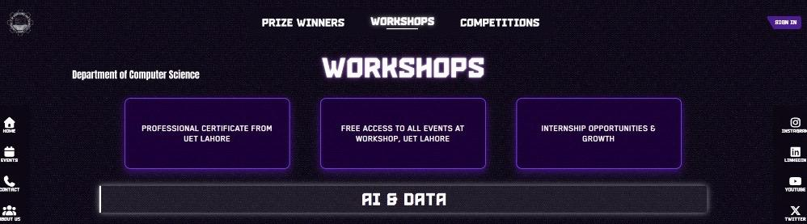
Website Overview
Main landing section displaying workshop highlights and navigation.

Slide 4
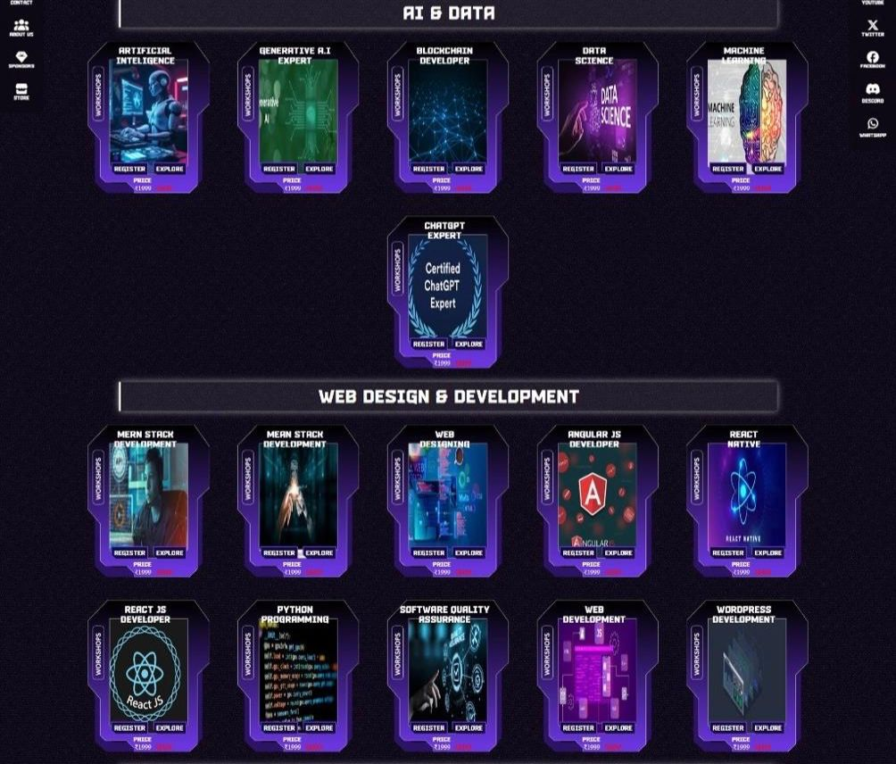
Workshop Categories
.
Categorized workshops allowing users to explore different technology domains.

Slide 5

Course Card Design
.
Action buttons
Each card provides course title, action buttons, and pricing details

Slide 6
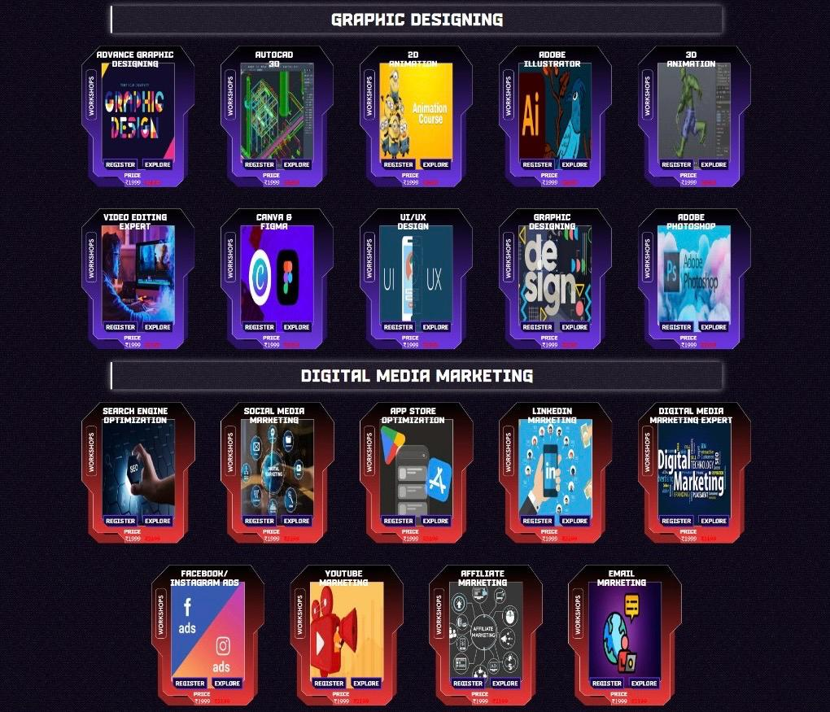
Platform Coverage
.
Wide range of workshops covering technical and creative fields.

Slide 7
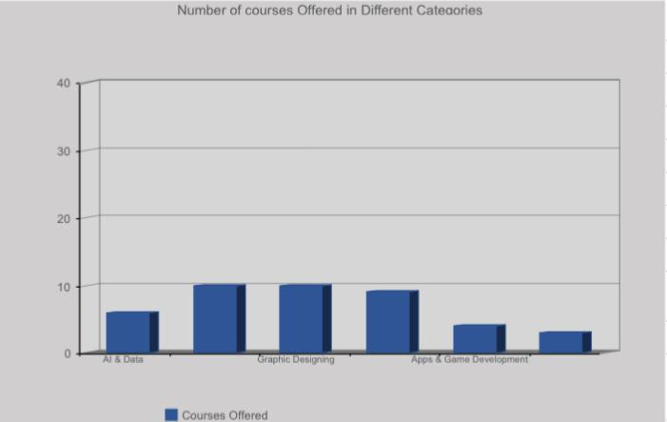
Workshop Data Analysis
Excel-based data analysis representing the offered number of courses.

Slide 8
Design Decisions
Dark theme chosen for a modern tech-focused look.
Purple and red accents used for visual hierarchy.
Card-based layout for easy scanning.
Consistent typography and spacing across sections.

Slide 9
Demo Link & GitHub 💻
Live Website : https://its-abuzar.github.io/Tech-Workshop-Website/index.html
GitHub Repository : https://its-abuzar.github.io/Tech-Workshop-Website/index.html

Slide 10
Reflection & Future Enhancements
Successfully implemented a structured workshop showcase
Improved understanding of UI design principles
Future plans include:
Individual course detail pages
Online registration system
Backend database integration

Slide 11
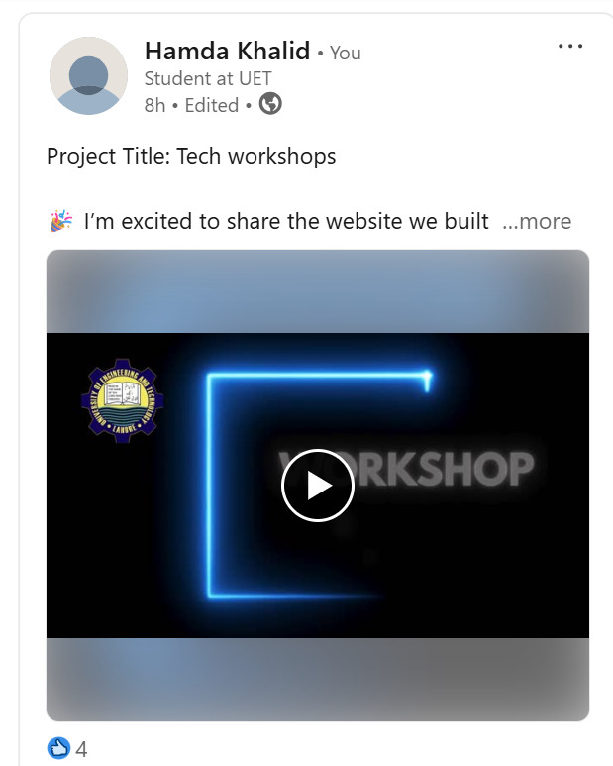
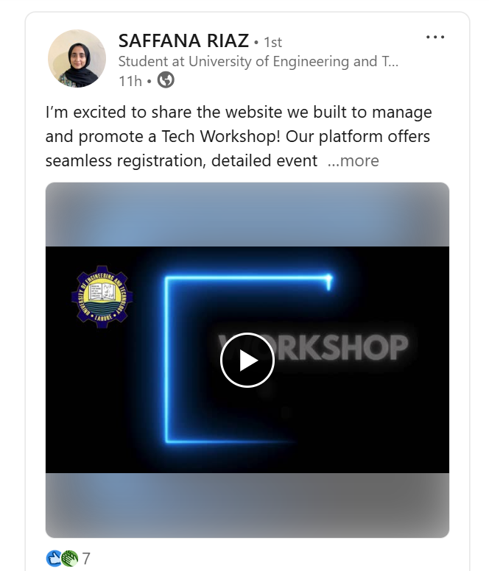
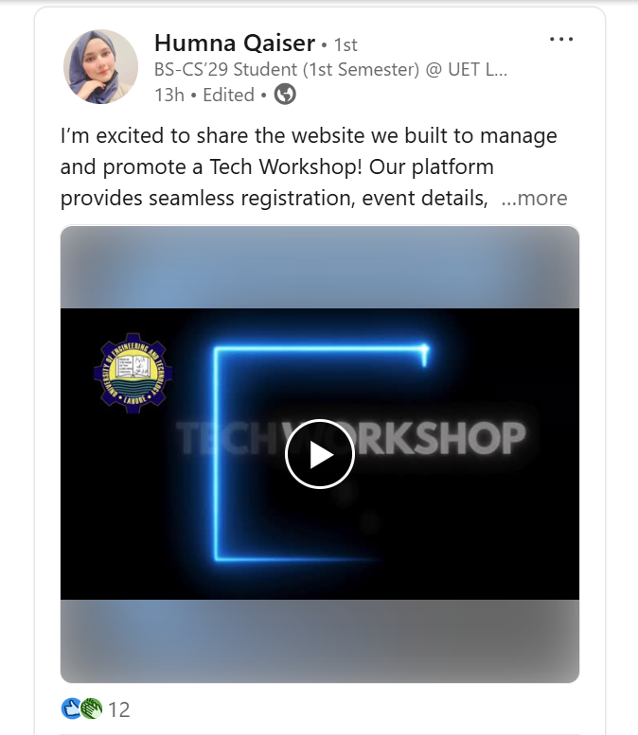
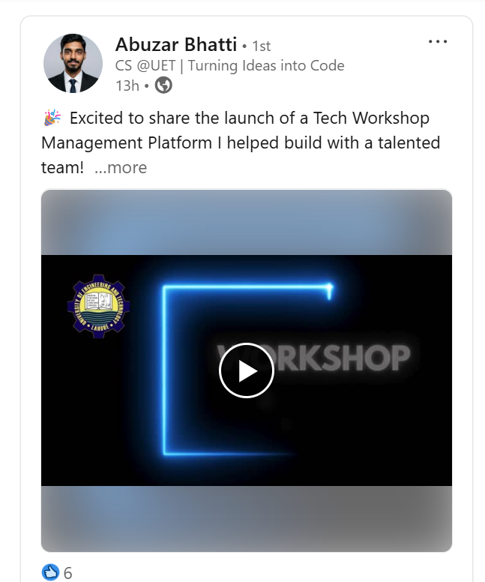
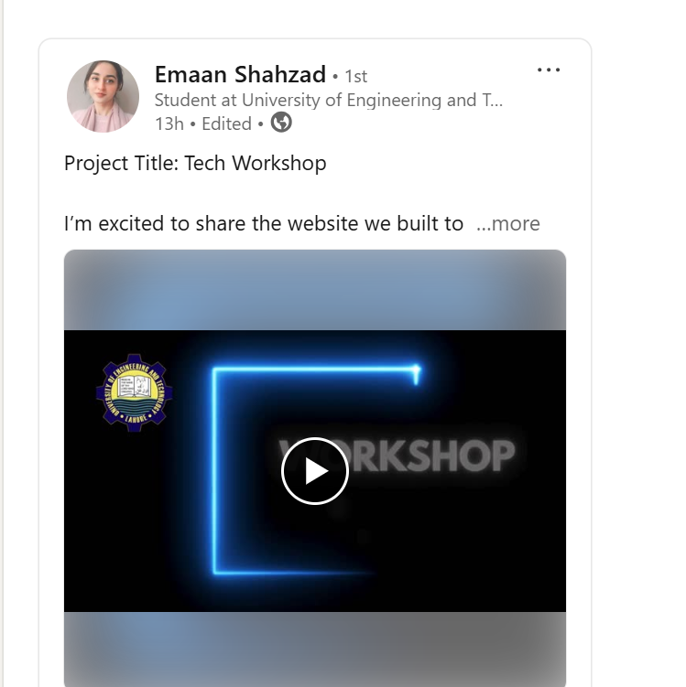
Linkedin Screenshots
.

